Slide 1

E-Commerce Customer Behavior &
Sales Analysis (Turkish Company)

Slide 2
Introduction
This project focuses on analyzing E-commerce customer behavior and sales performance for a Turkish retail company. The goal of the analysis is to uncover insights that can help the business understand its customers, improve marketing strategies, and increase overall sales performance.
OBJECTIVES:
Identify top-performing products and cities.
Examine payment preferences.
Analyze monthly revenue trends.
Understand the relationship between discounts and customer loyalty.

Slide 3
Dataset Overview
The dataset contains 5,000 rows and 23 columns.
It covers customer behavior and sales transactions from a Turkish E-commerce company
Time period: January 2023 to March 2024
Key variables includes:
Customer details: Age, Gender, City, Returning Customers, etc.
Sales Info: Product Category, Unit Price, Quantity, Discount, Total Amount
Purchase Behavior: Device Type, Payment Method, Duration, Session Time, Customer Rating.

Slide 4
Data Cleaning and Preparation
We used Python for cleaning and analysis.
No missing values or duplicates found.
Changed Date column to DateTime data type
Extracted Day, Month, and Year from the Date column
Created additional column (Total Price)
Confirmed valid date for only 3 months in 2024 (Jan-Mar)
Ensured numeric columns like Unit Price, Quantity, and Discount were properly formatted.

Slide 5
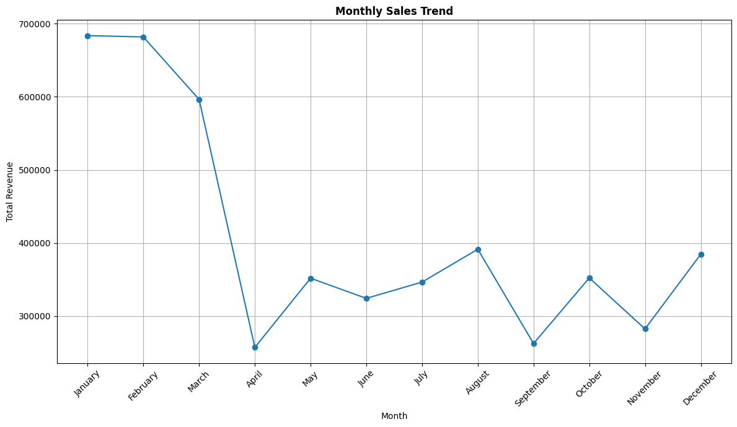
Monthly Sales Trend
Analysis
January recorded the highest revenue with the total amount of 68,569.24 followed by February (681,697.98) and March (596,348.77).
There was a sharp drops in April while August, October and December take over.
April recorded the least revenue with the total amount of 257,332.58 .

Slide 6
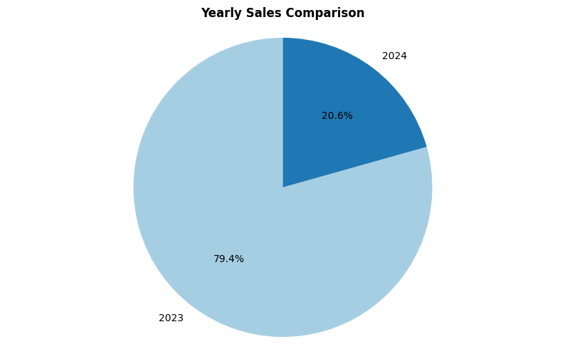
Yearly Sales Comparison
2023 recorded the highest share of revenue at 79.4%, while 2024 contributed 20.6%. It is important to note that the 2024 figure reflects only the first quarter (January to March).

Slide 7
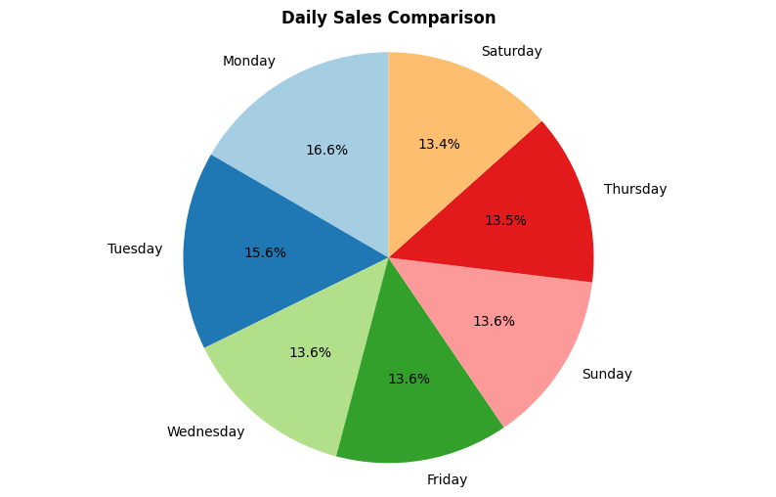
Daily Sales Comparison
Monday recorded the highest sales with ₦817,399.03, making it the top-performing day of the week. This was followed closely by Tuesday with ₦768,221.72.
In contrast, Saturday had the lowest sales at ₦659,414.02, indicating relatively weaker weekend performance.

Slide 8
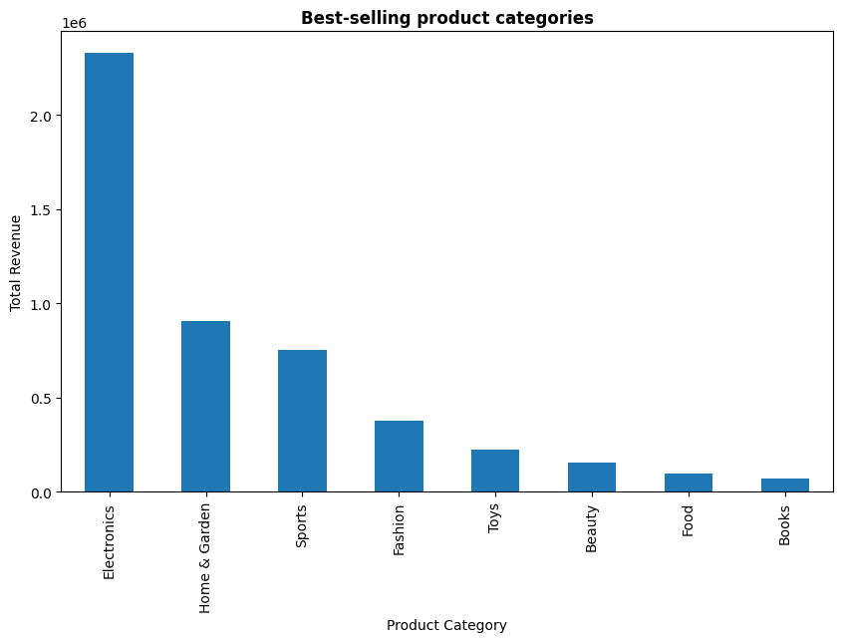
Best Selling Product Category
Electronics generated the highest total revenue at ₦2,328,806.81, making it the top-performing category. This was followed by Home & Garden, which recorded ₦908,348.86 in total revenue.
At the lower end, Books recorded the least revenue with ₦72,744.52, indicating minimal customer spending in this category.

Slide 9
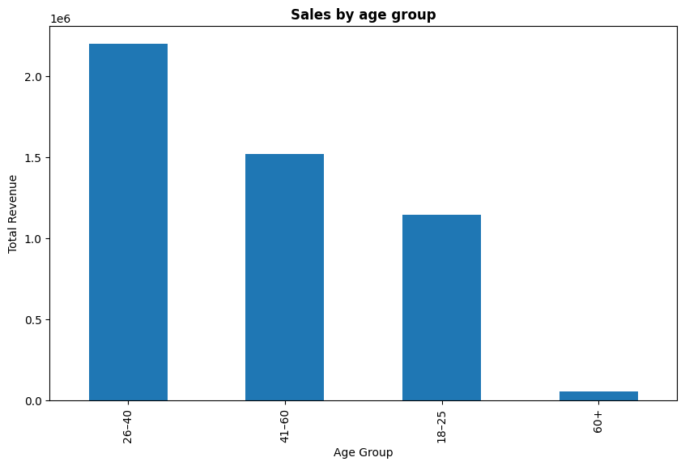
Sales By Age Group
Customers aged 26–40 recorded the highest sales, making them the most valuable age segment. They were followed by customers aged 41–60.
Meanwhile, customers aged 60 and above generated the lowest sales, showing the least spending activity among all age groups.

Slide 10
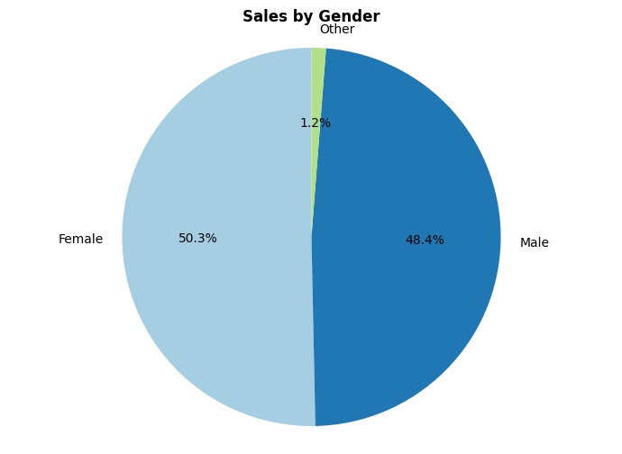
Sales By Gender
The female segment recorded the highest number of orders and generated the most revenue. However, the gap between female and male customers is not very large, indicating that there is still room to improve engagement and sales across both genders.

Slide 11
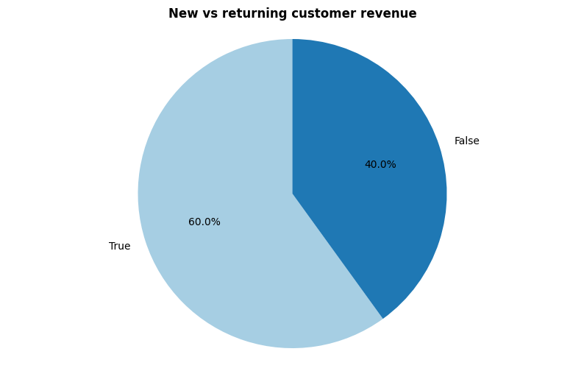
New vs Returning Customer Revenue
Returning customers generated 60% of the total revenue, while new customers contributed 40%.
(On the chart, True represents Returning Customers, and False represents New Customers)

Slide 12
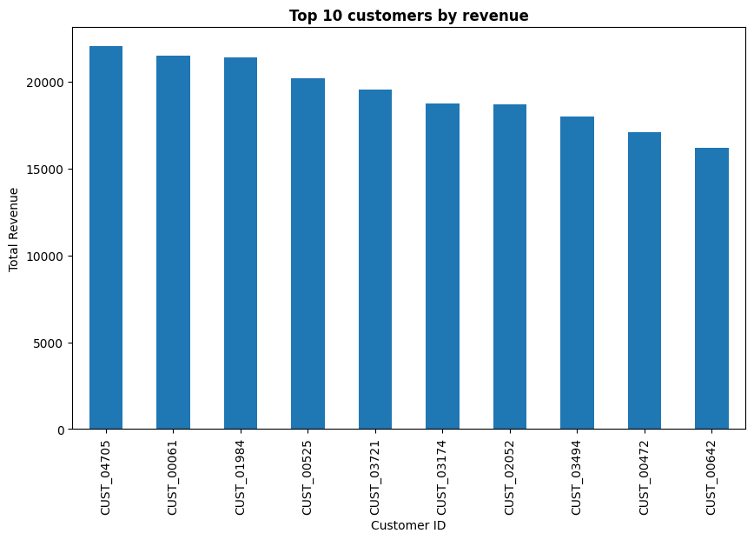
Top 10 Customers by Revenue
Customer 04705 generated the highest revenue, followed by Customer 00061 and Customer 01948, making them the top three contributors to total sales.

Slide 13
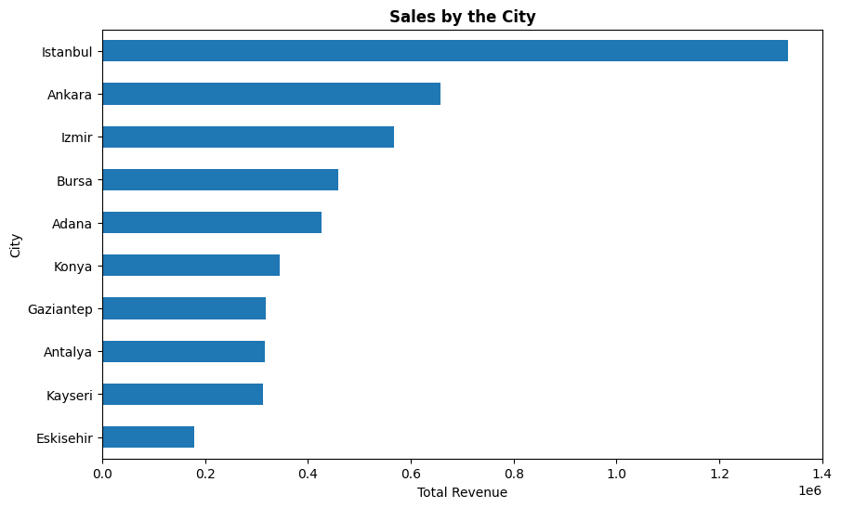
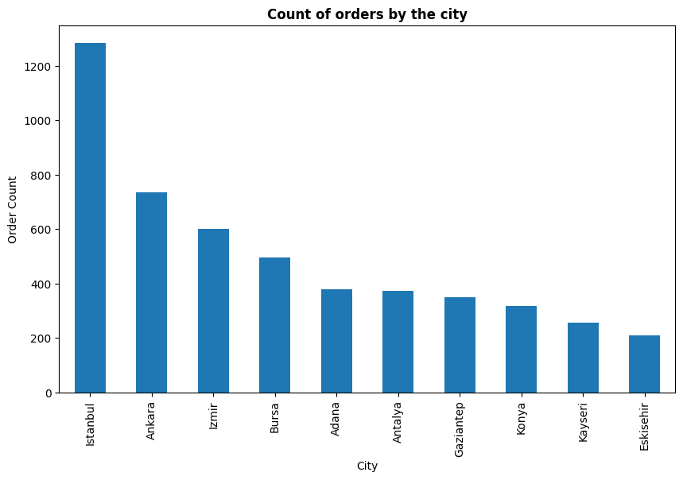
Sales and Count of Orders by the City
Istanbul recorded the highest sales and number of orders, followed by Ankara and Izmir. In contrast, smaller cities such as Kayseri and Eskisehir contributed fewer sales and the lowest number of orders.

Slide 14
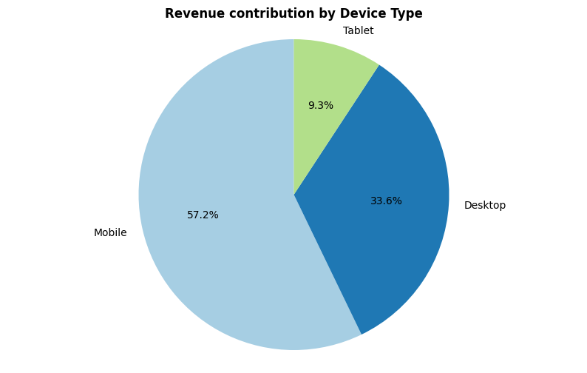
Revenue Contribution by Device Type
Mobile devices contributed the highest revenue at 57.2%, followed by Desktop with 33.6%. Tablet recorded the lowest contribution at 9.3%.

Slide 15
Most Preferred Payment Method
Mobile devices contributed the highest revenue at 57.2%, followed by Desktop with 33.6%. Tablet recorded the lowest contribution at 9.3%.

Slide 16
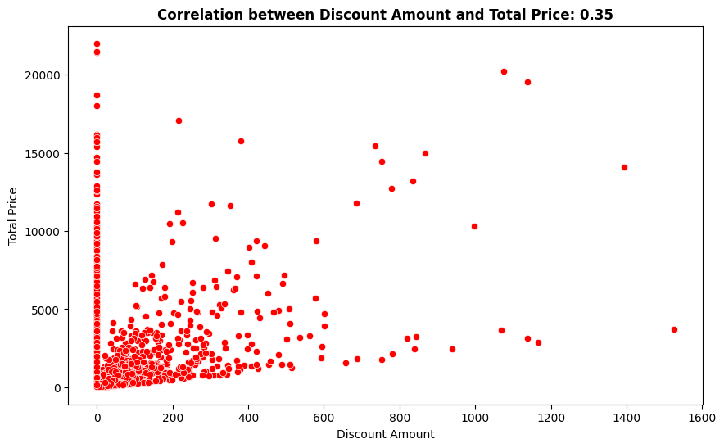
Correlation Between Discount Amount and Total Price
The correlation between Discount Amount and Total Price is 0.35, which indicates a moderate positive relationship.
This means:
As discount amount increases, the total price also tends to increase.
Customers who receive higher discounts are often purchasing more expensive items or larger quantities, resulting in a higher total price even after the discount.
The relationship is not very strong, but it is meaningful, suggesting that discounts are often used on higher-value purchases.
Overall, this implies that discounts are positively associated with bigger transactions, and customers who spend more tend to receive or use higher discount amounts.

Slide 17
Key insights
2023 has the highest revenue share at 79.4%, while 2024 contributes 20.6% (only Jan–Mar)
Highest sales occur on Monday, followed by Tuesday; lowest on Saturday
Majority of customers come from major cities like Istanbul, Ankara, and Izmir
Electronics and Home & Garden generate most revenue; Books generate the least
Customers aged 26–40 contribute the highest sales; customers 60+ contribute the least
Returning customers generate 60% of revenue; new customers 40%
Female customers record the highest orders and revenue, but the gap with male customers is small
Mobile devices dominate revenue contribution at 57.2%, followed by Desktop (33.6%) and Tablet (9.3%)
Top customers by revenue: 04705, 00061, 01948
Correlation insights: Quantity vs Total Price (–0.00) → no relationship; Discount vs Total Price (0.35) → moderate positive; Pages Viewed vs Session Duration (0.02) → no relationship

Slide 18
Conclusion
Revenue Trends: 2023 generated the highest revenue, while 2024 shows potential for growth despite only reflecting the first quarter.
Customer Behavior: Most revenue comes from returning customers, customers aged 26–40, and those in major cities like Istanbul and Ankara. Female customers slightly outperform males in orders and revenue.
Product and Channel Performance: Electronics and Home & Garden dominate sales, with mobile devices being the preferred channel for purchases. Books and tablets contribute the least.
Sales Patterns: Sales peak at the start of the week (Monday–Tuesday) and dip on weekends. Discounts moderately drive higher total revenue, while session engagement metrics (pages viewed, session duration) have little correlation with sales.
Overall: Revenue is concentrated among a few products, cities, and customer segments, highlighting both strengths and opportunities for growth in underperforming segments.

Slide 19
Recommendations
1. Expand Customer Engagement:
Target new customers and smaller cities (e.g., Kayseri, Eskisehir) to increase revenue diversity.
Encourage male and older customers to increase adoption and spending.
2. Product Strategy:
Promote underperforming categories (e.g., Books) with targeted discounts or bundles.
Focus marketing and inventory on high-performing categories like Electronics and Home & Garden.
3. Sales & Marketing Timing:
Optimize promotions around peak sales days (Monday–Tuesday).
Consider weekend campaigns to boost lower-performing days.
4. Channel Optimization:
Enhance mobile experience, since mobile drives majority revenue.
Improve desktop and tablet experiences to capture additional sales.
5. Customer Retention & Loyalty:
Strengthen loyalty programs for returning customers, as they generate the majority of revenue.
Personalize offers based on customer age, location, and past purchase behavior.
6. Discount & Revenue Strategy:
Use discounts strategically on high-value products, as higher discounts moderately correlate with higher total revenue.

Slide 20
THANK YOU

